Slide 1
EXERCISE SESSION 4
Clustering

Slide 2
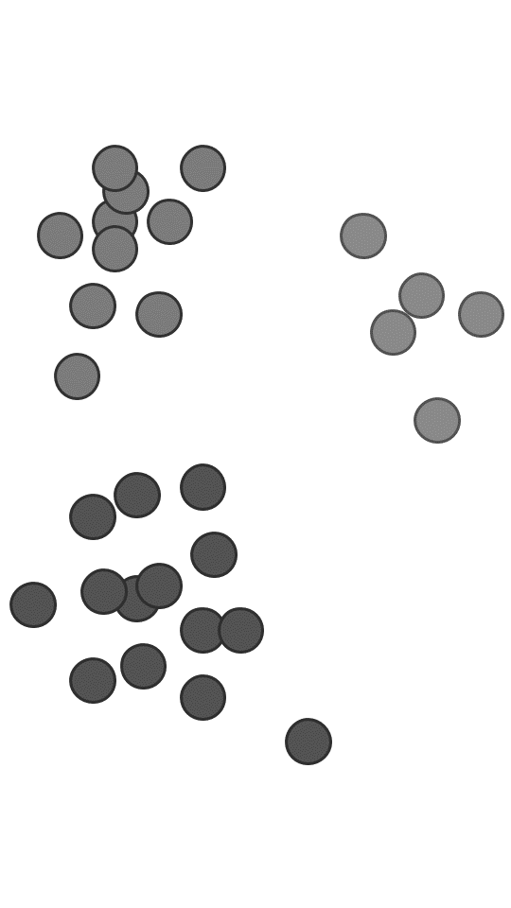
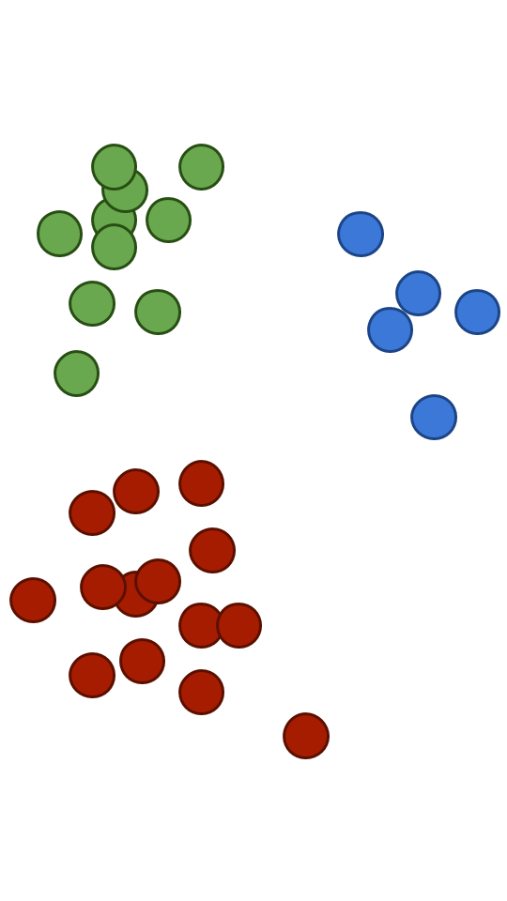
What is clustering
Grouping a set of objects in such a way that objects in the same group (cluster) are more similar to each other than to those in other groups.
Unsupervised: no ground truth.

Slide 3
In this session
k-means
Gaussian Mixture Models (GMM / EM)
Hierarchical clustering
Agglomerative
Divisive
BIRCH algorithm

Slide 4
1. k-means + EM

Slide 5
k means
Chose the number of clusters k
Randomly pick k centroids c₁, …, c_{k}
Assign each data point to the cluster with the closest centroid
Re-compute centroids c₁, …, c_{k}
Repeat steps 3 – 4 till the stopping criteria is met

Slide 6
GMM
Model-based approach.
Assumption: data is generated from a number of different Gaussian distributions.
GMM is fit with the EM algorithm.
Soft assignment: each data point belongs to many clusters with different probabilities.

Slide 7
2. Hierarchical Clustering

Slide 8
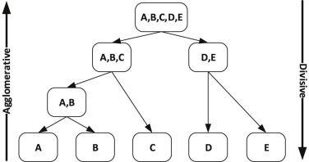
2. Hierarchical Clustering
AGGLOMERATIVE
DIVISIVE
Bottom-up:
Top-down:

Slide 9
2.1 Agglomerative Clustering

Slide 10
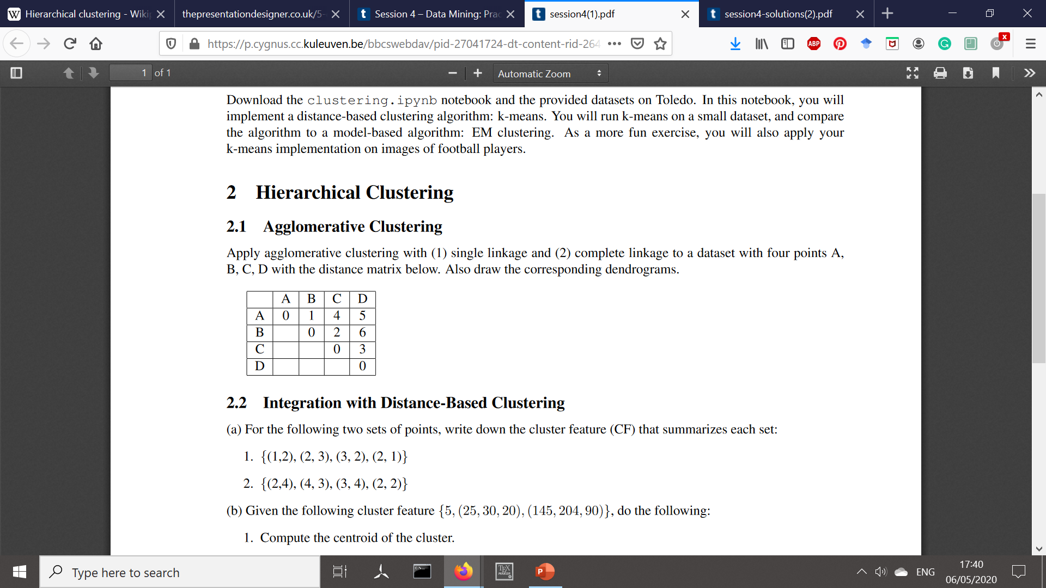
2.1 Agglomerative clustering
Basic idea: start with a separate cluster with each point, repeatedly merge closest clusters together.
How to measure distances between the clusters?
Single linkage: distance between two clusters = distance between their closest points.
Complete linkage: distance between two clusters = distance between their furthest points.

Slide 11
2.1 Agglomerative clustering
Single linkage
{A} {B} {C} {D}
d({A}, {B}) = 1, d({A}, {C}) = 4, d({A}, {D}) = 5,
d({B}, {C}) = 2, d({B}, {D}) = 6, d({C}, {D}) = 3
{A, B} {C} {D}

Slide 12
2.1 Agglomerative clustering
Single linkage
{A, B} {C} {D}
d({A,B}, {C}) = min{d(A, C), d(B, C)} = min{4, 2} = 2
d({A,B}, {D}) = min{d(A, D), d(B, D)} = min{5, 6} = 5
d({C}, {D}) = 3
{A, B, C} {D}

Slide 13
2.1 Agglomerative clustering
Single linkage
{A, B, C} {D}
{A, B, C, D}

Slide 14
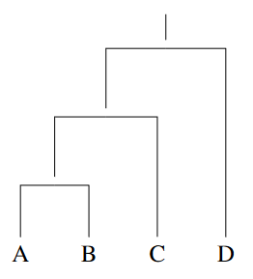
2.1 Agglomerative clustering
Single linkage
{A} {B} {C} {D}
{A, B} {C} {D}
{A, B, C} {D}
{A, B, C, D}

Slide 15
2.1 Agglomerative clustering
Complete linkage
{A} {B} {C} {D}
d({A}, {B}) = 1, d({A}, {C}) = 4, d({A}, {D}) = 5,
d({B}, {C}) = 2, d({B}, {D}) = 6, d({C}, {D}) = 3
{A, B} {C} {D}

Slide 16
2.1 Agglomerative clustering
Complete linkage
{A, B} {C} {D}
d({A,B}, {C}) = max{d(A, C), d(B, C)} = max{4, 2} = 4
d({A,B}, {D}) = max{d(A, D), d(B, D)} = max{5, 6} = 6
d({C}, {D}) = 3
{A, B} {C, D}

Slide 17
2.1 Agglomerative clustering
Complete linkage
{A, B} {C, D}
{A, B, C, D}

Slide 18
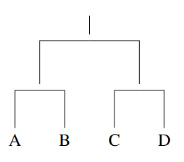
2.1 Agglomerative clustering
Complete linkage
{A} {B} {C} {D}
{A, B} {C} {D}
{A, B} {C, D}
{A, B, C, D}

Slide 19
2.2 Cluster Features

Slide 20
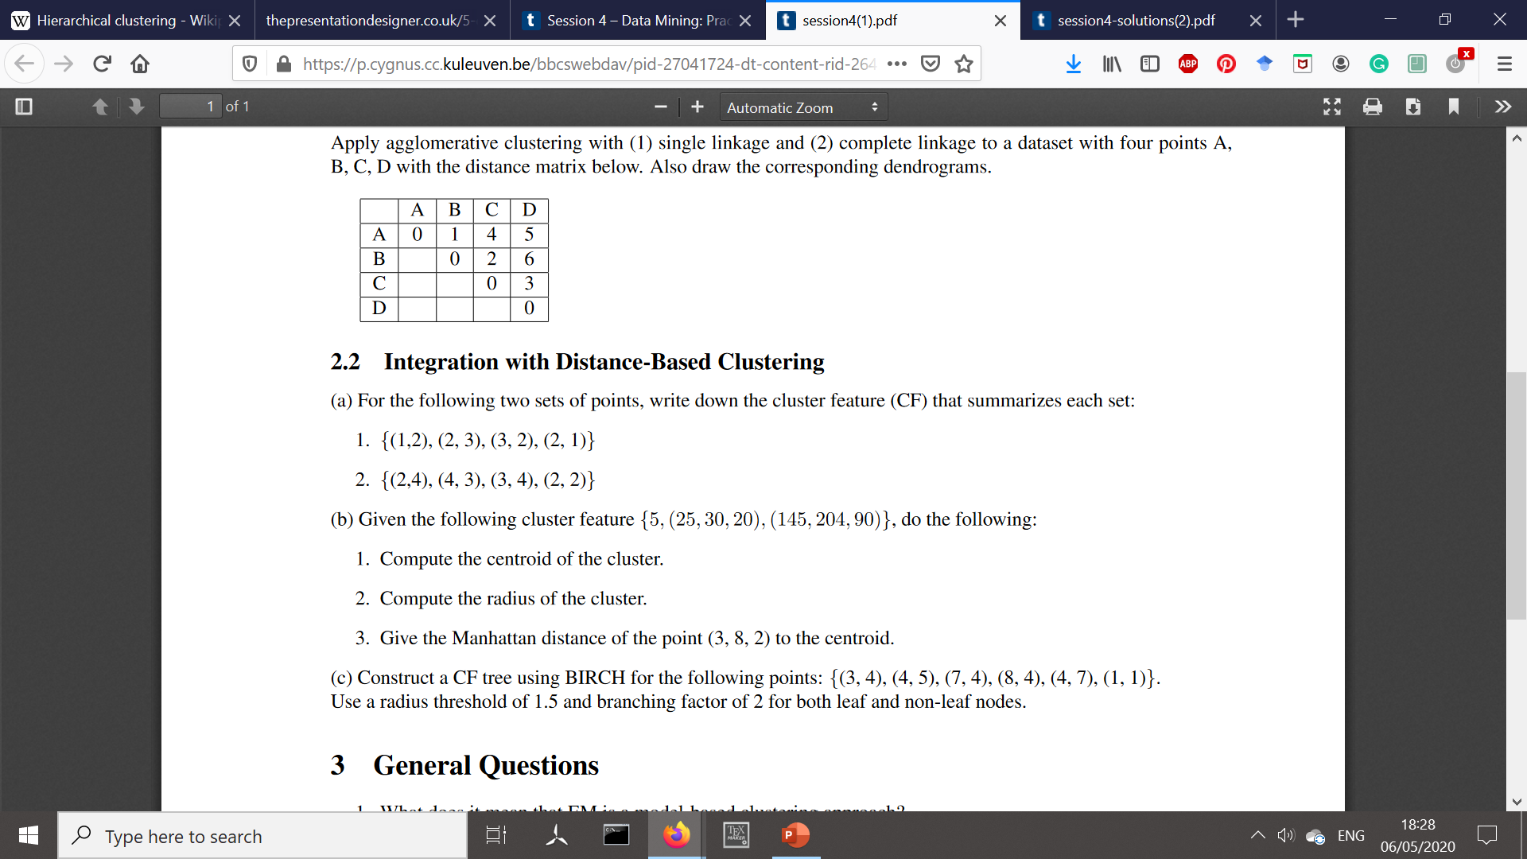
2.2a Cluster Features (CFs)
SS
CF = (n, (Sx, Sy), (SSx, SSy)) CF = (n, (Sx, Sy), SSx+SSy)
1.
n = 4 points
Sx = 1 + 2 + 3 + 2 = 8 SSx = 1 + 4 + 9 + 4 = 18
Sy = 2 + 3 + 2 + 1 = 8 SSy = 4 + 9 + 4 + 1 = 18
CF = (4, (8, 8), 18 + 18) = (4, (8, 8), 36)

Slide 21
2.2b Cluster Features (CFs)
CF = (n, (Sx, Sy, Sz), (SSx, Ssy, SSz)
c = (Sx/n, Sy/n, Sz/n) = (25/5, 30/5, 20/5) = (5, 6, 4)

Slide 22
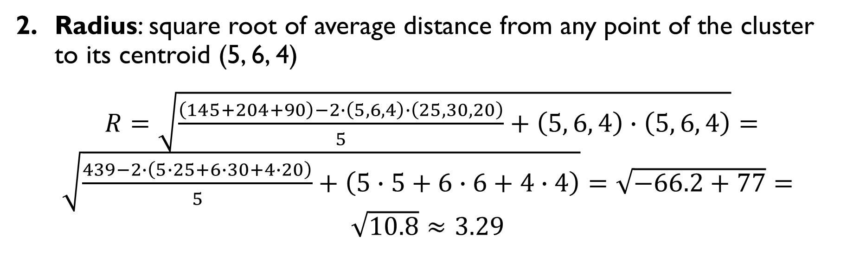
2.2b Cluster Features (CFs)
CF = (n, (Sx, Sy, Sz), (SSx, Ssy, SSz)
Radius: square root of average distance from any point of the cluster to its centroid (5, 6, 4)
$R=\sqrt{\frac{\left(145+204+90\right)−2∙\left(5, 6, 4\right)∙\left(25, 30, 20\right)}{5}+\left(5, 6, 4\right)∙\left(5, 6, 4\right)}=\sqrt{\frac{439−2∙\left(5∙25+6∙30+4∙20\right)}{5}+\left(5∙5+6∙6+4∙4\right)}=\sqrt{−66.2+77}=\sqrt{10.8}≈3.29$

Slide 23
2.2b Cluster Features (CFs)
CF = (n, (Sx, Sy, Sz), (SSx, Ssy, SSz)
3.
c = (5, 6, 4)
d((3, 8, 2), c) = |3 - 5| + |8 - 6| + |2 - 4| = 2 + 2 + 2 = 6

Slide 24
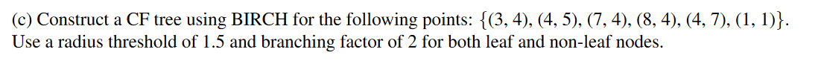
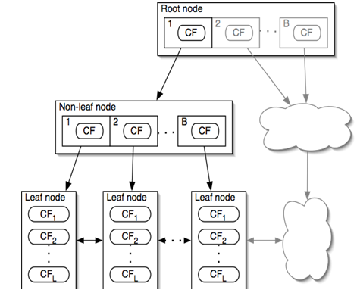
2.2c BIRCH Algorithm
BIRCH summarizes a dataset into a set of subclusters to reduce the scale of the clustering problem.
Scalable One pass through the data CF tree-based
CF tree:
entry = CF = subcluster, not a datapoint;
non-leaf nodes contain at most B entries;
leaf nodes contain at most L entries;
radius threshold in leaves.

Slide 25
2.2c BIRCH Algorithm
The points are added one by one.
Insertion:
Find the closets leaf.
Add the point to the closest subcluster in that leaf, if possible.
If radius exceeds the threshold, add it as a separate entry to the leaf.
If leaf already has L entries, split it (and maybe its parents)

Slide 26
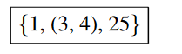
2.2c BIRCH Algorithm
1. Add (3, 4) to the top node
CF becomes (1, (3, 4), 25)

Slide 27
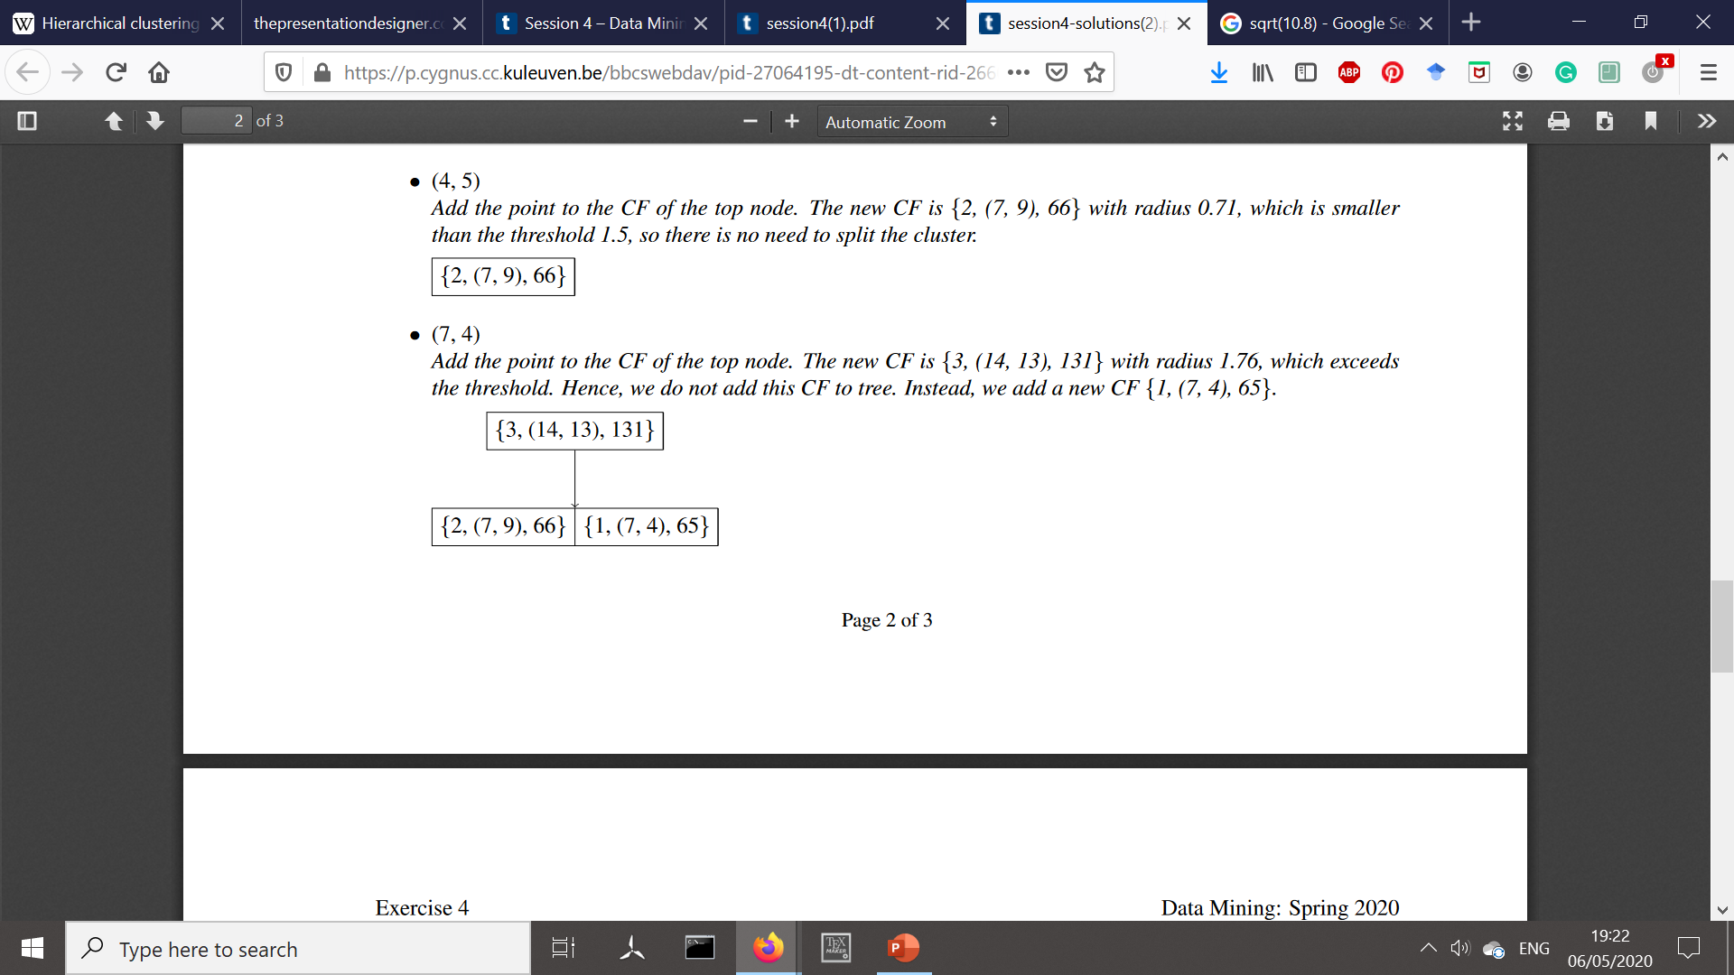
2.2c BIRCH Algorithm
1. Add (4, 5) to the top node
CF would become
(2, (3+4, 4+5), 25+41) =(2, (7, 9), 66)
R = 0.71 < 1.5 OK
Add (4,5) to the same subclaster

Slide 28
2.2c BIRCH Algorithm
1. Add (7, 4) to the top node
CF becomes (3, (14, 13), 131)
R = 1.76 > 1.5 NOT OK
Can we add new entry in the root node? YES.

Slide 29
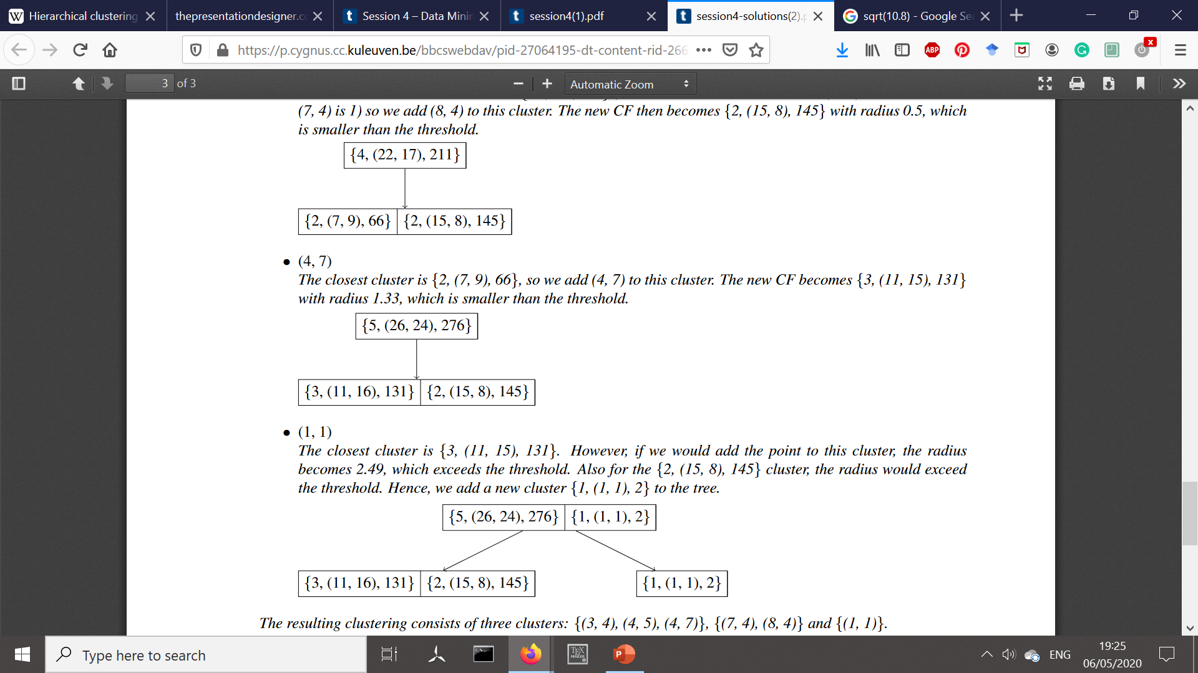
2.2c BIRCH Algorithm
1. Add (8, 4) to the top node
Which cluster to add this point to?
d((8, 4), (3.5, 4.5)) = 5
d((8, 4), (7, 4)) = 1 R = 0.5 - OK

Slide 30
2.2c BIRCH Algorithm
1. Add (4, 7) to the top node
Which cluster to add this point to?
d((4, 7), (3.5, 4.5)) = 4 R = 1.33 - OK
d((4, 7), (7.5, 4)) = 6.5

Slide 31
2.2c BIRCH Algorithm
1. Add (1, 1) to the top node
Which cluster to add this point to?
d((1, 1), (3.67, 5.33)) R = 2.49 > 1.5 – NOT OK
d((1, 1), (7.5, 4)) Can we add new entry to the root node? NO => SPLIT THE ROOT

